Slide 1
Welcome to Stars Dashboard
Top most popular actors and credits

Slide 2
Check out our Data
Most popular actors and movies scraped from IMDB site.
Actors - https://www.imdb.com/list/ls022928819/
Actresses - https://www.imdb.com/list/ls022928836/
Scraped using OMDb API - http://www.omdbapi.com/
Data saved to CSV files
Data include actor information, actor credits, movie ratings, box office revenue, and genre
Actor and Actresses data were combined
Data loaded into SQLLite in Actor and Movies entities

Slide 3
Questions on Data
Who are the top 10 popular actors?
Who are the top 10 popular actresses?
What are the top 10 movies at the box office?
How many movies are made in the US?
How do US movies compare with foreign films in revenue?
Is there a correlation between IMDB Ratings and Box office revenues?
Do IMDB Ratings translate to higher revenues?

Slide 4
Data Exploration
15,358 titles found between the year 1937 to 2022.
Titles include project announcements
Titles were of type episode, game, series, and movie.
Among all titles, 12,259 were of movie type.
9889 movies were made in the US.
200 actors in the dataset
Actors took 24 different types of credits

Slide 5
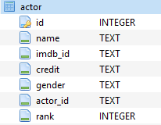
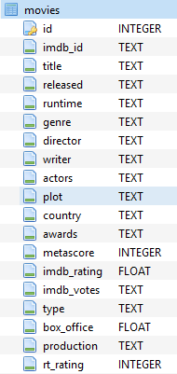
Check out our IMDb Schema
Data from our entities Actor and Movies

Slide 6
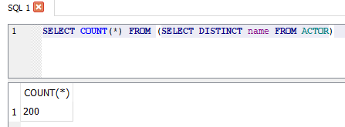
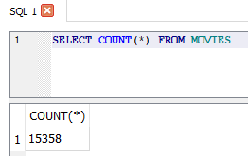
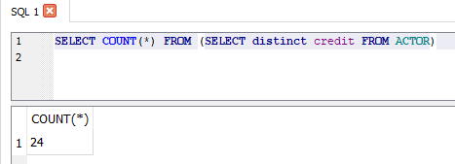
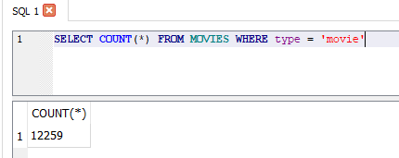
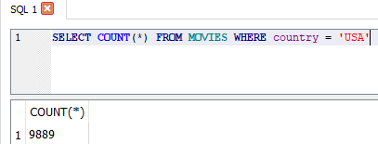
A few queries on Data

Slide 7
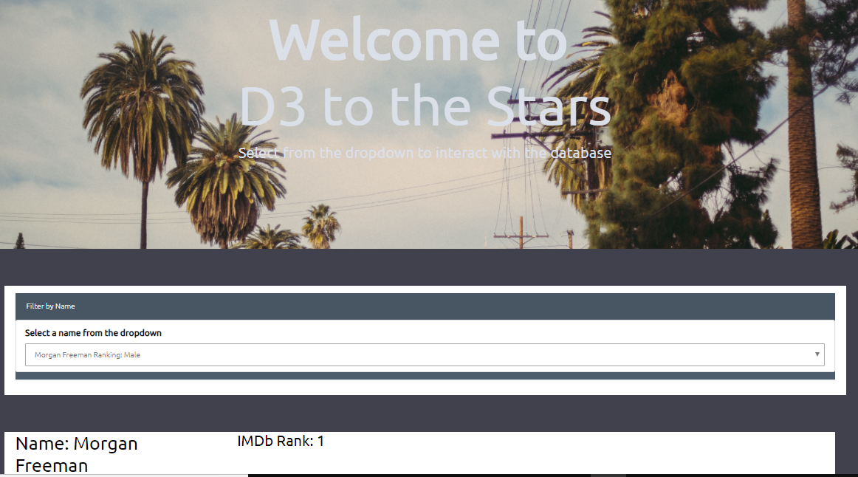
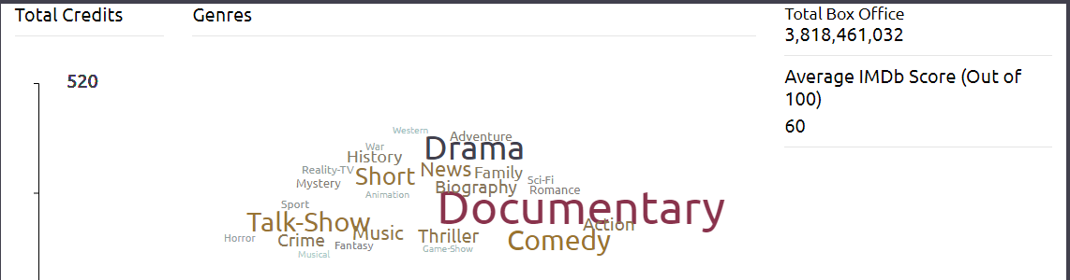
Check out our dashboard
CHART WILL GO HERE
1
Choose an Actor from the Dropdown.
2
Total Credits, Box Office Revenue, Average IMDb Score is displayed

Slide 8
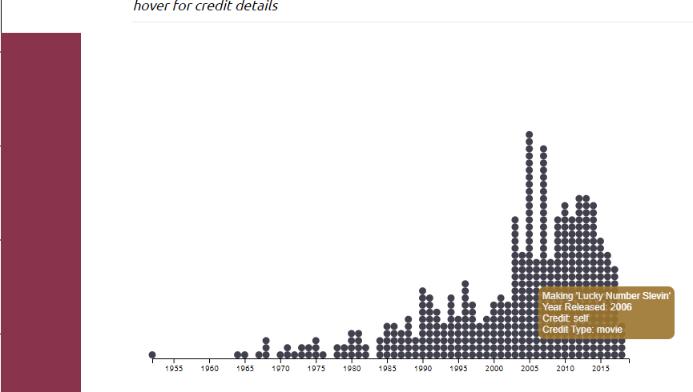
Explore credit details
3
Hover over to display credit details in the chart

Slide 9
Conclusions
For future exploration we would like to see correlation between IMDb ratings and Box office revenues

Slide 10
More questions about our Dashboard?
We are glad to answer
Notes:
In Slide Show mode, click the arrows to visit links.

